Slide 1
Using Git
With GitHub for Windows or Mac
(This is for if you're not using the lab machines)
Creating a new Project Repository
Sharing the Repository with the instructor(s)
Downloading Repository from server to harddrive
Adding new files
Creating a commit
Pushing to/Syncing with the server
Pulling new changes

Slide 2
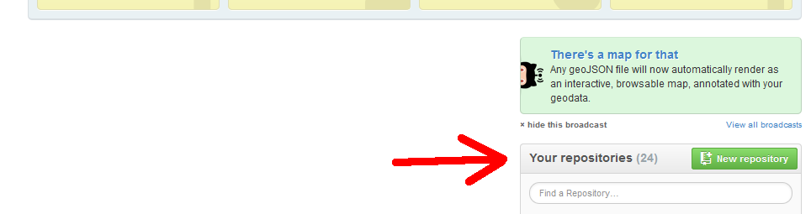
1. Creating a new Project Repository
From https://github.com/, scroll down until you see the green New repository button under the Your repositories section. Click the button.

Slide 3
1. Creating a new Project Repository
On the Create a New Repository page, fill out the following:
  Repository Name: CS201
  Description: Optional
  Select Private radio button
    If it asks for a credit card, you haven't been activated as a student account yet. See week 1 slides
  Check Initialize this repository with a README
  From the dropdown box, select C++ as the language

Slide 4
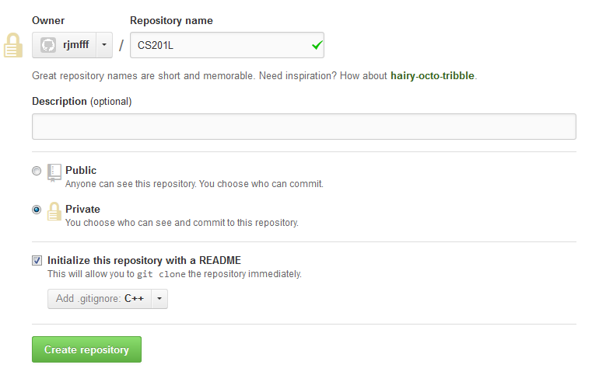
1. Creating a new Project Repository

Slide 5
1. Creating a new Project Repository
You will need to create an additional repository if you're in the CS 201 Lab.
  CS 201
  CS 201 L

Slide 6
2. Sharing your Repositories
For CS 201, you will need to share your repository with Rachel.
For CS 201 L, you will need to share your repository with Imrul and Rachel.

Slide 7
2. Sharing your Repositories
From your Repository website,
https://github.com/YOUR_USERNAME/CS201
Click on the Settings button.

Slide 8
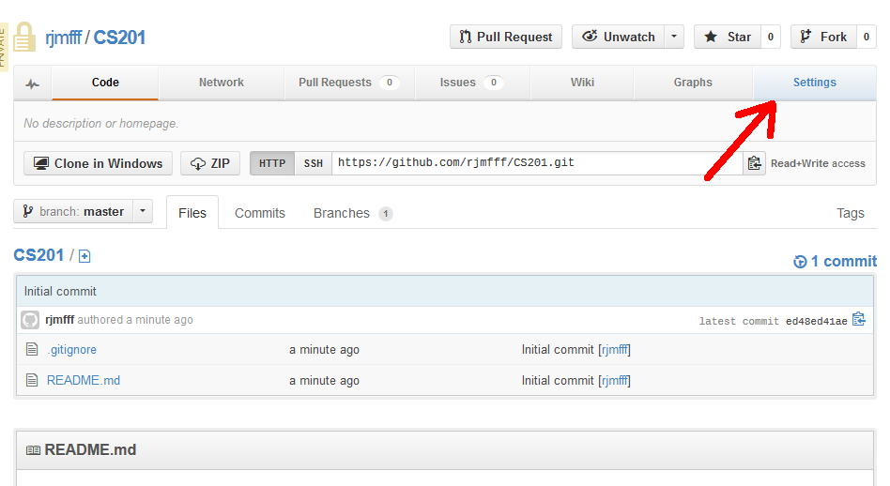
2. Sharing your Repositories

Slide 9
2. Sharing your Repositories
From the Settings page, click on the Collaborators tab.
In the Collaborators tab, enter our IDs:
  RJMFFF for Rachel (CS 201 and CS 201 L)
  Simrul for Imrul
  Usernames are not case-sensitive
Click on the Add button.

Slide 10
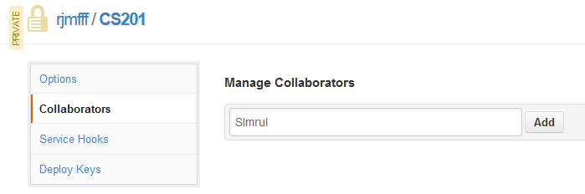
2. Sharing your Repositories

Slide 11
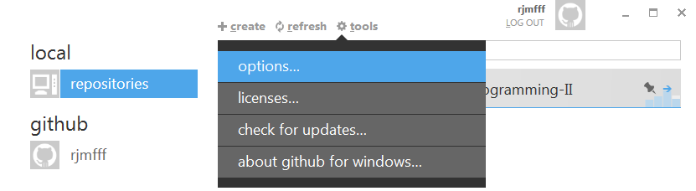
3. Setting up GitHub for Windows/Mac
Install GitHub for Windows/Mac and log into the client.
From the main page, click on the tools button and select options....

Slide 12
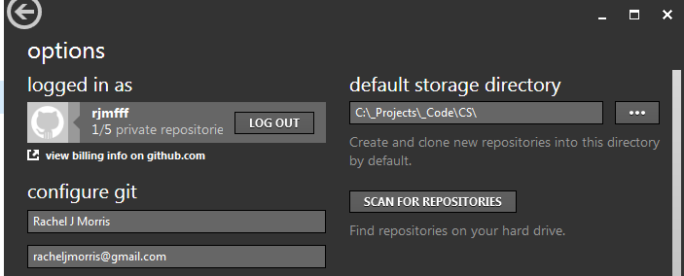
3. Setting up GitHub for Windows/Mac
Set the default storage directory to the location you prefer. This will also be the folder we create our C++ projects within.
Click update when done.

Slide 13
4. Downloading your Repository
The repository is currently only on the web server. To add and change files, you need to pull it down to your local machine.
You will modify files on your harddrive, and when you're done with a change, push them back to the server.

Slide 14
4. Downloading your Repository
Log into GitHub for Windows (or Mac) on your computer.
Select your username under the github section on the left.

Slide 15
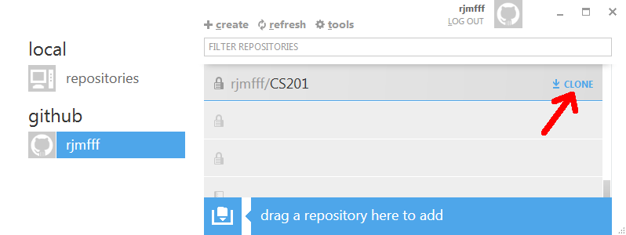
4. Downloading your Repository
Click on the Clone button next to your repositories.

Slide 16
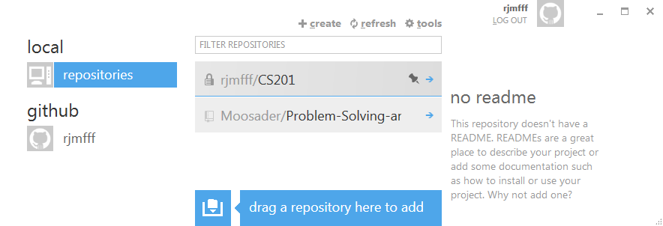
4. Downloading your Repository
Your repository will now show up under the local section when you click repositories.

Slide 17
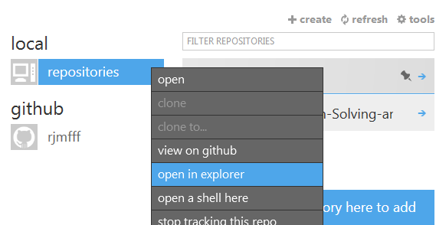
5. Adding a test file
Right-click on your CS201 Repository and select open in explorer.

Slide 18
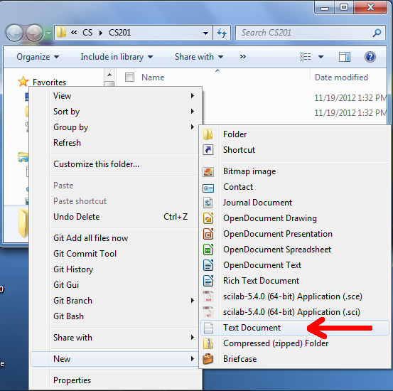
5. Adding a test file
Add a new text document.

Slide 19

5. Adding a test file
Go back to your GitHub client and double-click on the Repository name.

Slide 20
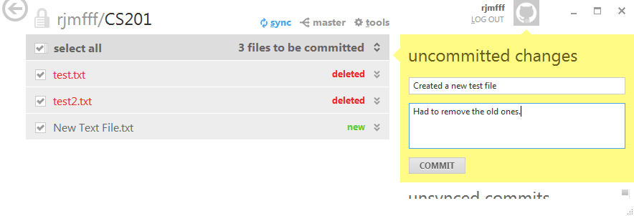
5. Adding a test file
The client will automatically detect any file changes. In the yellow region, enter a COMMIT MESSAGE, and an optional description if you want.

Slide 21
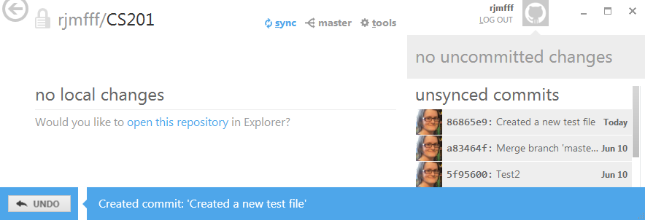
5. Adding a test file
Click commit and the left section will clear out.
On the right, you will see “unsynced commits”. These are changes you have committed, but are not on the server yet.

Slide 22
6. Viewing changes
You can click on a specific commit to see any changes that were made.

Slide 23
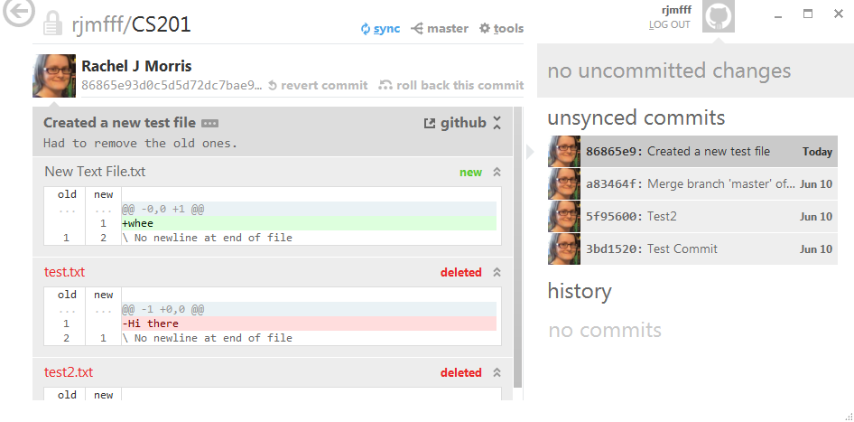
6. Viewing changes

Slide 24
7. Pushing your changes to the server
Click on the sync button to push your changes to the server.

Slide 25
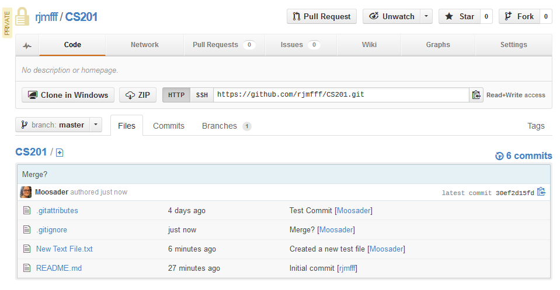
7. Pushing your changes to the server
Your changes will now be visible on the webpage.

